Slide 1


Project
Presentation

Slide 2

Student Event Participation

Slide 3

Project Mentor Team Members
Ankit Verma Vishwadev Gupta
Asif
Km Gauri
Neha Bansal

Slide 4

INTRODUCTION
The main purpose of this project is to provide the ease to the staff of our college to find out the student participation in the events . As it is too difficult to find such information , so our project provide the student participation information to the staff or faculty.

Slide 5

SCOPE OF THE PROJECT
The scope of this project is to provide the details of the event participation of events and to mange them. Its objective is to provide the ease to the admin , admin can be a class coordinator or any staff member of college . As it is too difficult to find such information for the coordinators and also to manage it . it also gives an additional feature that the user and admin can upload the job recruitment.

Slide 6
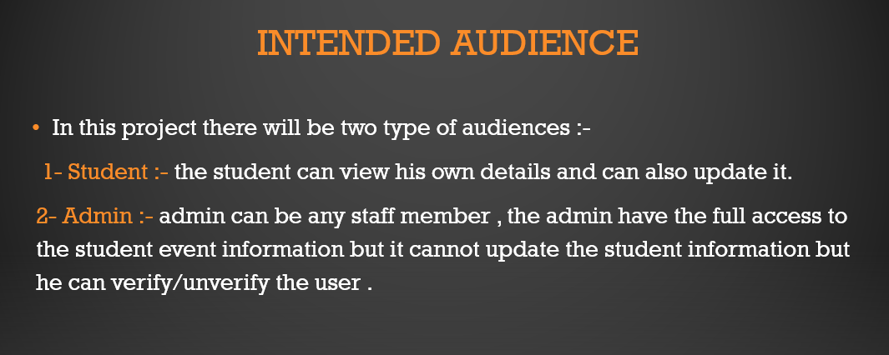

Slide 7





TECHNOLOGY USED

Slide 8

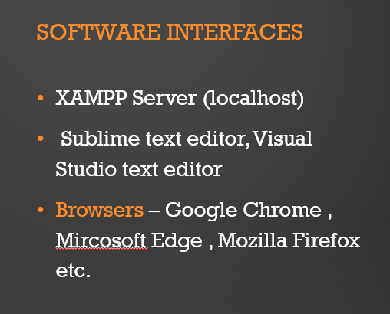

Slide 9

FEATURES OF THE PROJECT
FAST PERFORMANCE
RELIABLE PERFORMANCE
REMOTE LOGIN
MINIMISE POTENTIAL HUMAN ERRORS
EASY ACCESS TO THE DAY TO DAY ACTIVITIES
PARTICIPANTS CAN BE IDENTIFIED EASILY
AWARENESS OF JOB

Slide 10

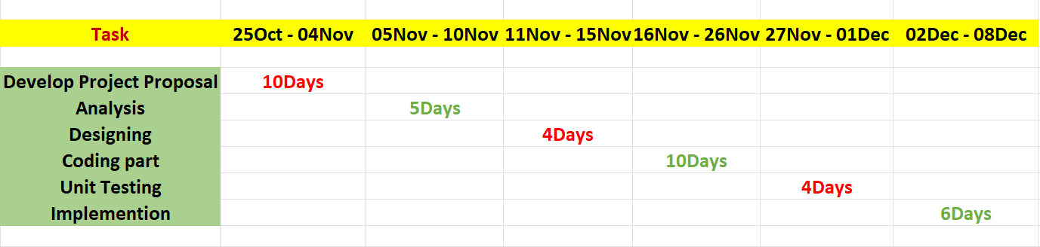
PLANNING STEP

Slide 11
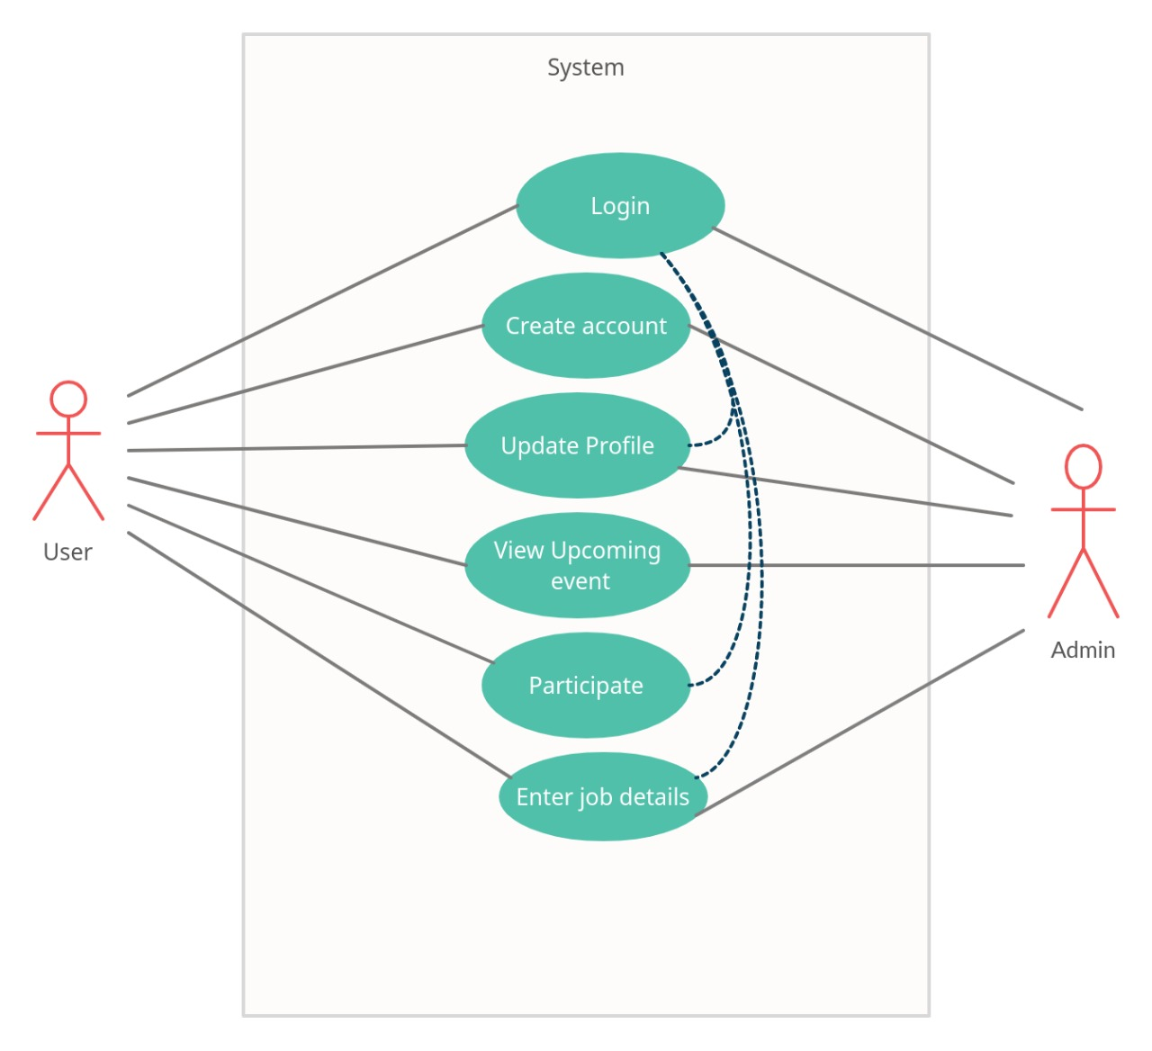
USE CASE

Slide 12
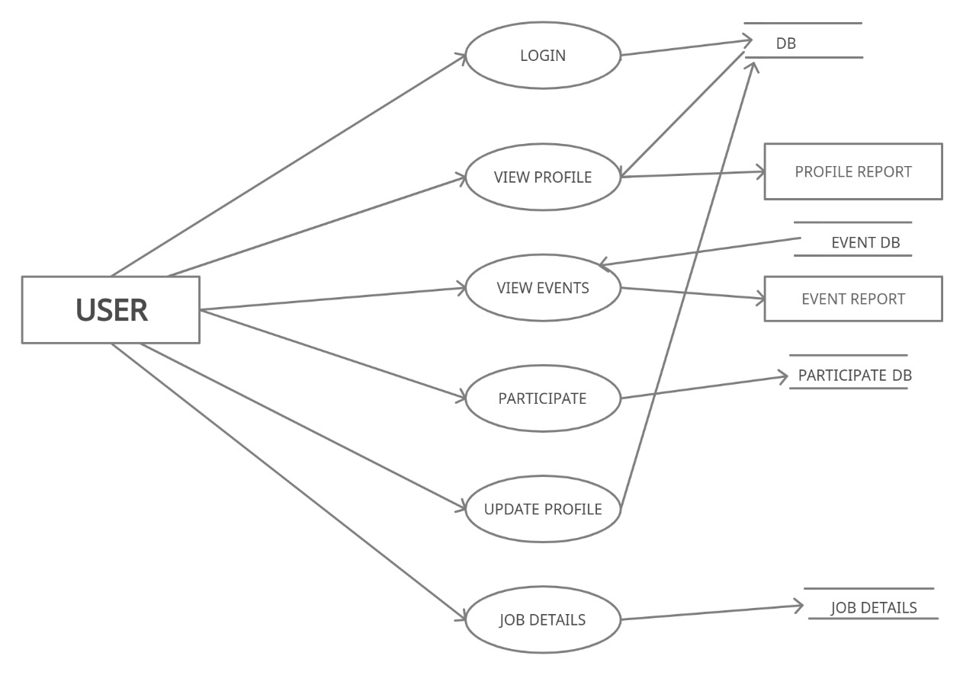
DFD USER

Slide 13
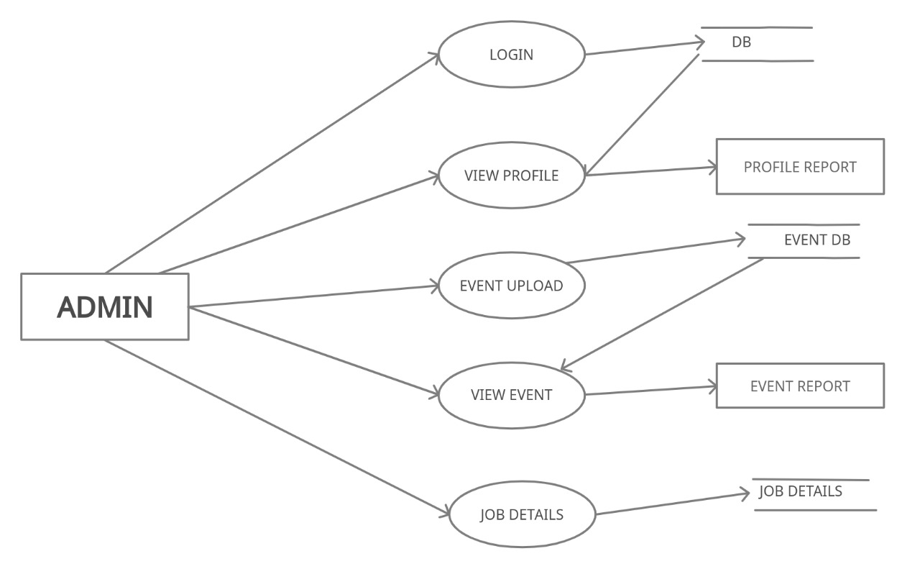
DFD ADMIN

Slide 14
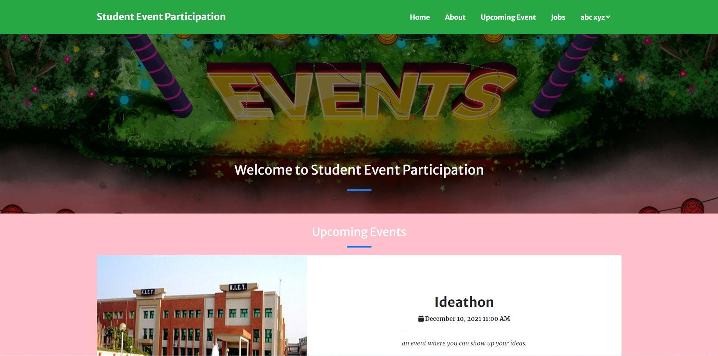
USER INTERFACE (HOME PAGE)

Slide 15
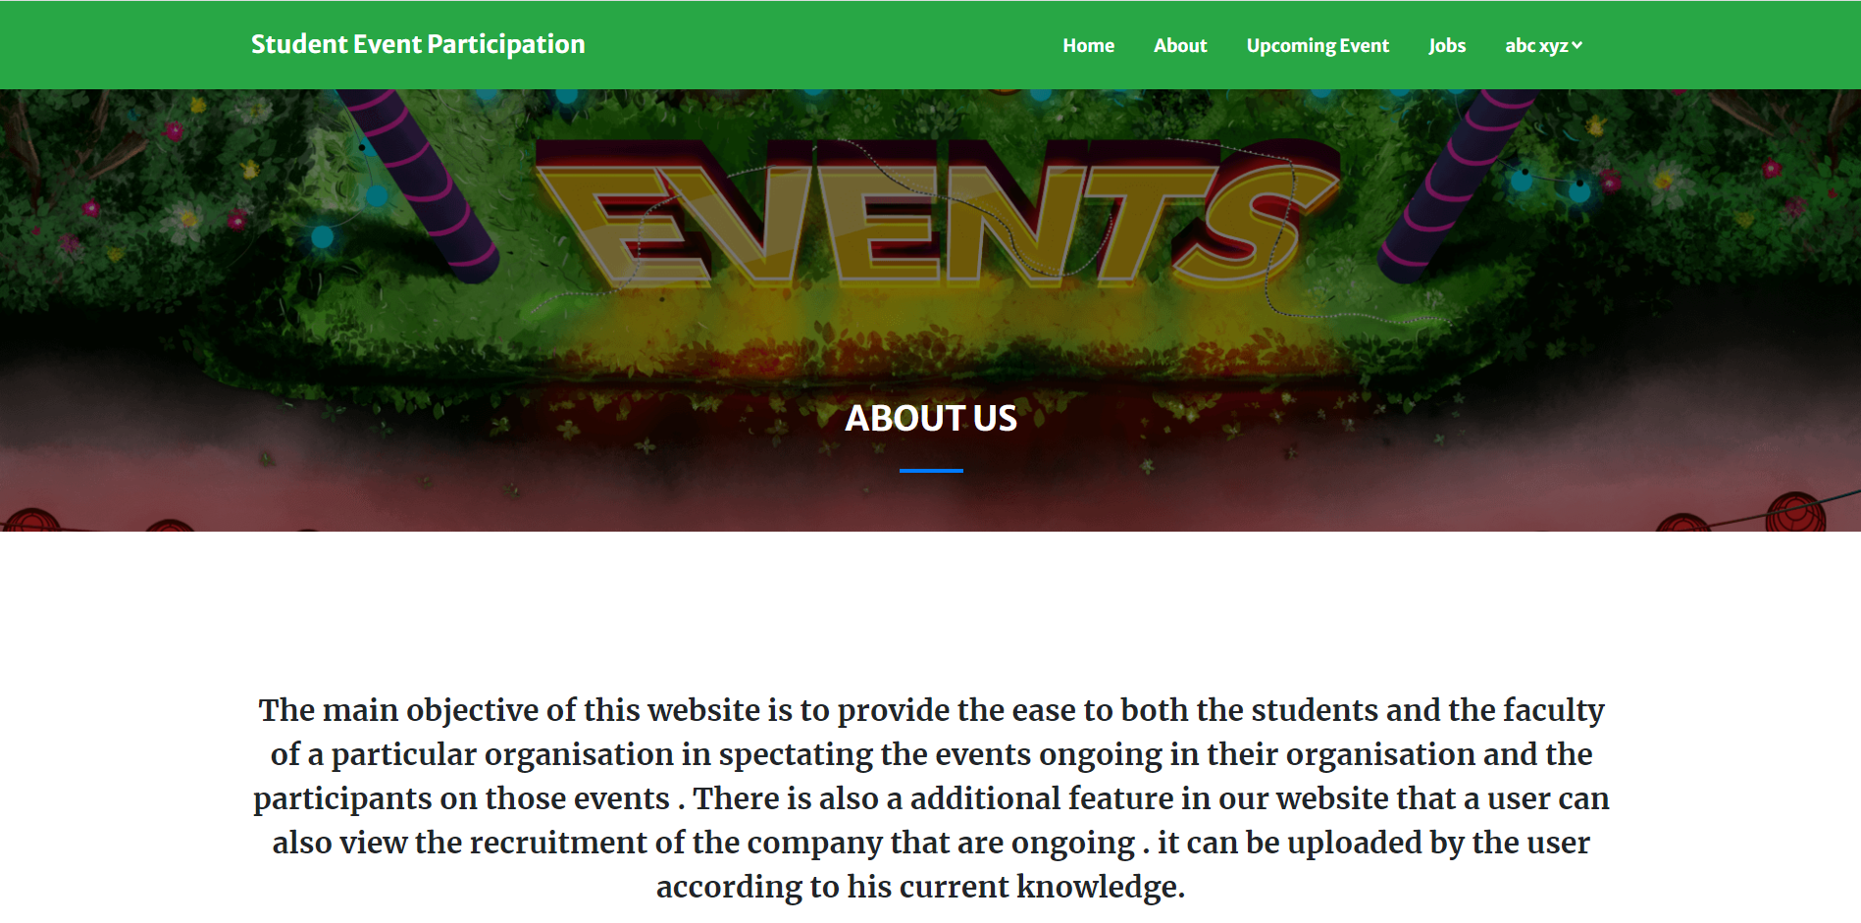
ABOUT

Slide 16
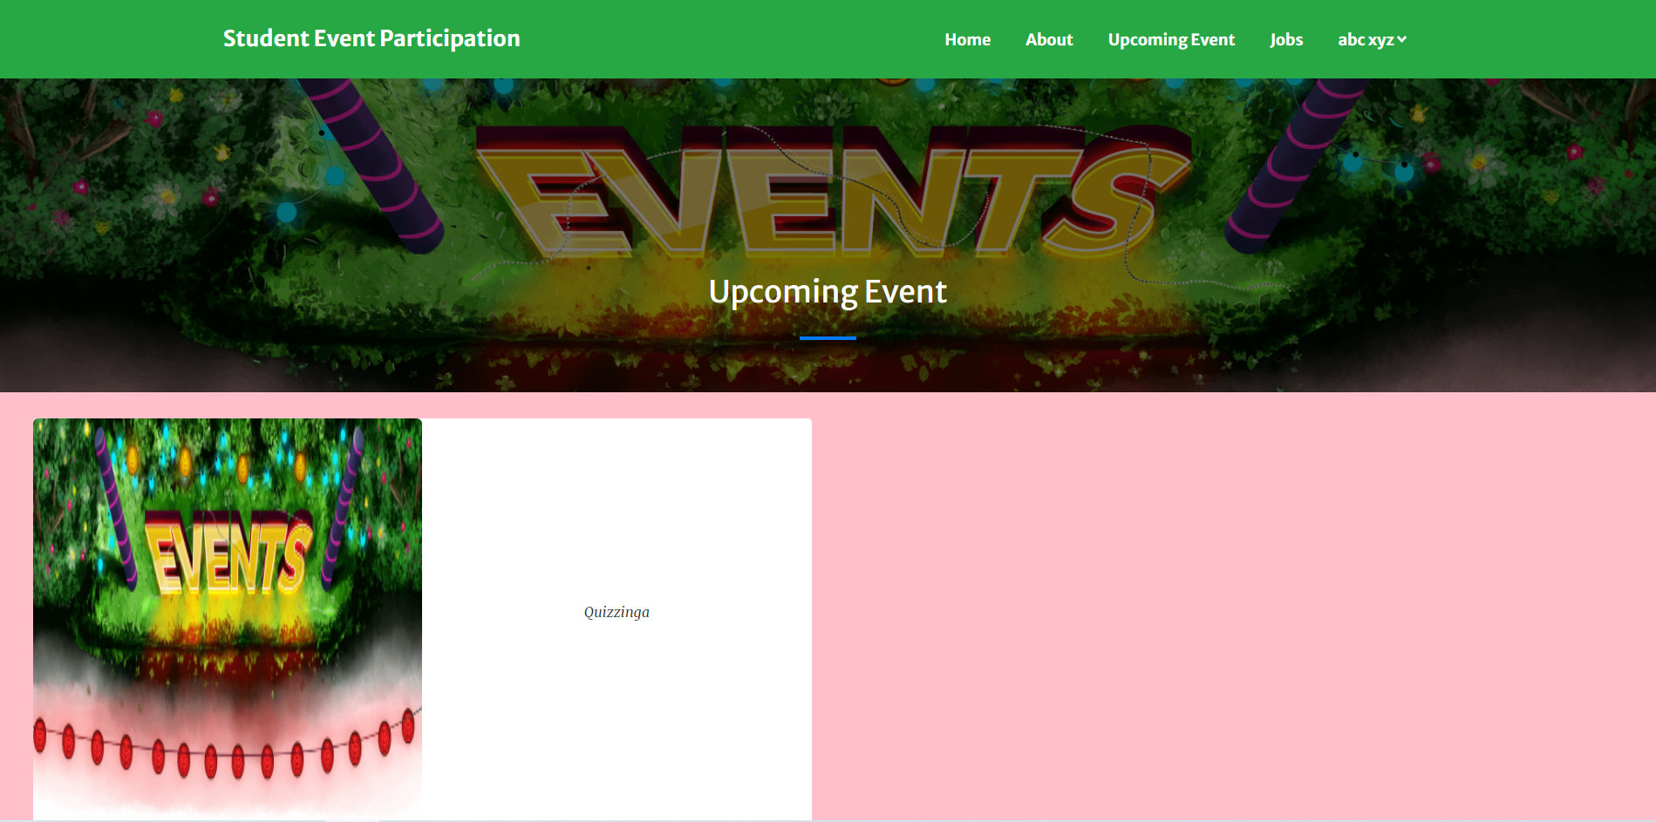
UPCOMING EVENTS

Slide 17
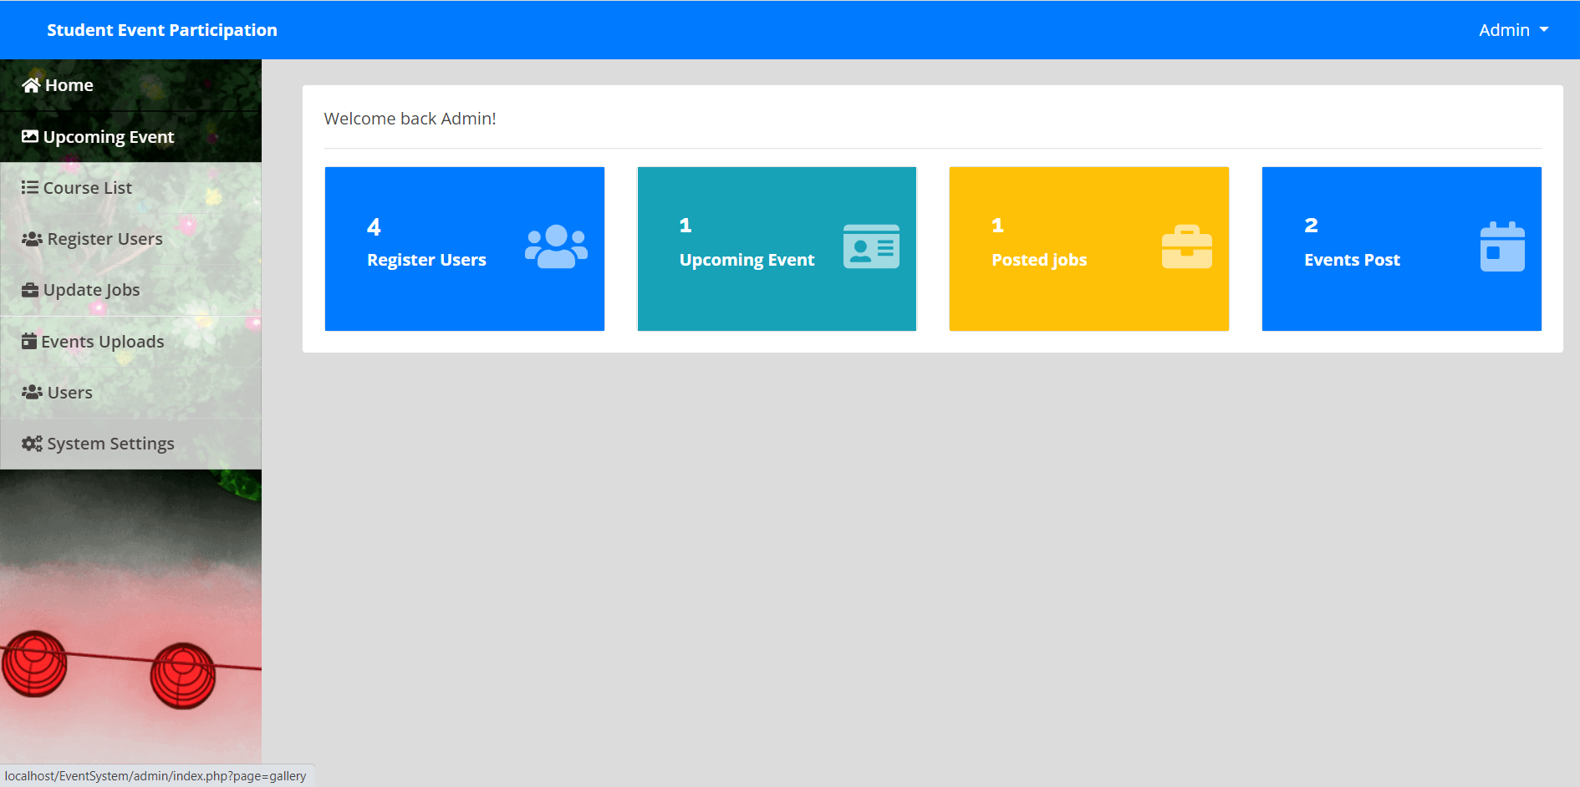
ADMIN PANEL

Slide 18

DO YOU HAVE ANY QUESTION ? PLEASE ASK AND GIVE THE FEEDBACK

